Slide 1
Programmed Cell Death (Apoptosis) in Animal Development

Slide 2
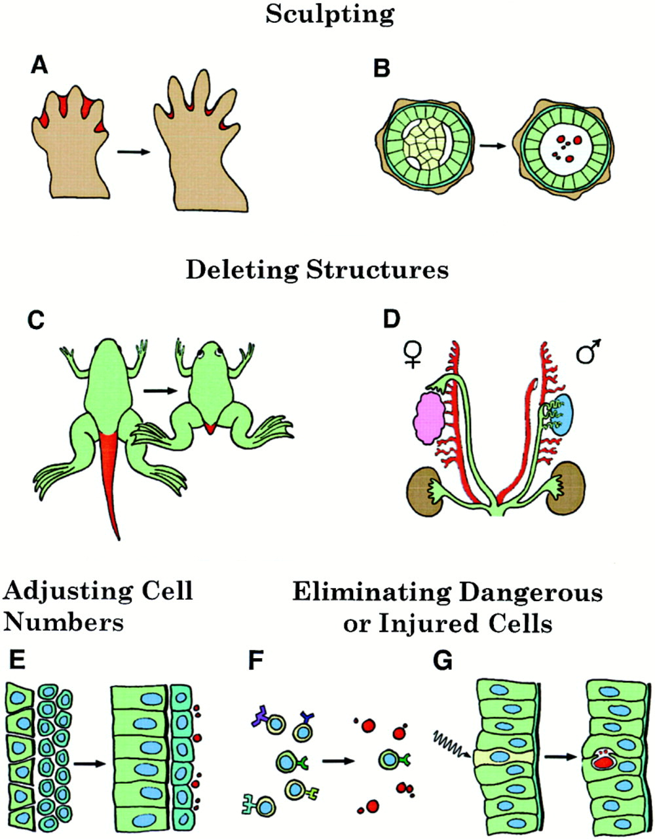
Programmed Cell Death (Apoptosis) in Animal Development
Jacobson et al., Cell, 1997

Slide 3
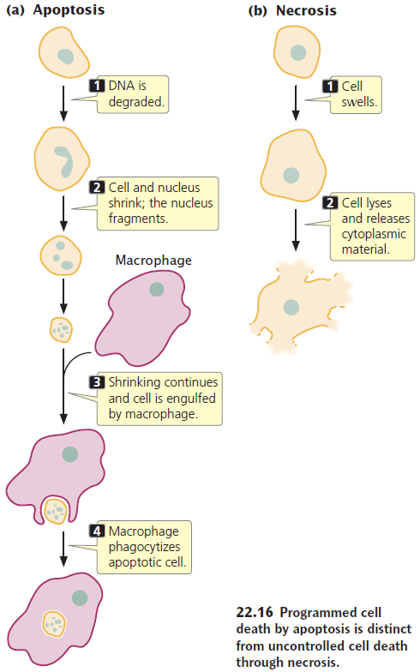
Apoptosis is distinct from uncontrolled cell death through necrosis

Slide 4
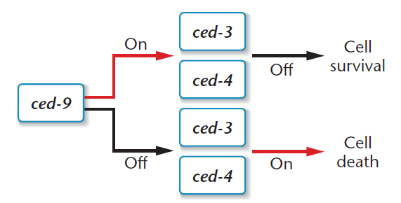
Apoptosis pathway in C. elegans
Apoptosis pathways were first discovered in C. elegans in 1986.
CED-3 is a caspase that degrades proteins triggering cell death.
Homologous caspases leading to cell death were discovered in higher organisms.

Slide 5
Some targets of caspases
More than a dozen protein kinases, including focal adhesion kinase ( FAK ), PKB, PKC, and Raf1. Inactivation of FAK, for example, is presumed to disrupt cell adhesion, leading to detachment of the apoptotic cell from its neighbors. Inactivation of certain other kinases, such as PKB, serves to disrupt prosurvival signaling pathways. Caspases also disrupt the generation of survival signals by inactivating the NF‐kB pathway.
Lamins, which make up the inner lining of the nuclear envelope. Cleavage of lamins leads to the disassembly of the nuclear lamina and shrinkage of the nucleus.
Proteins of the cytoskeleton, such as those of intermediate filaments, actin, tubulin, and gelsolin. Cleavage and consequent inactivation of these proteins lead to changes in cell shape.
An endonuclease called caspase-activated DNase (CAD), which is activated following caspase cleavage of an inhibitory protein. Once activated, CAD translocates from the cytoplasm to the nucleus where it attacks DNA, severing it into fragments.

Slide 6
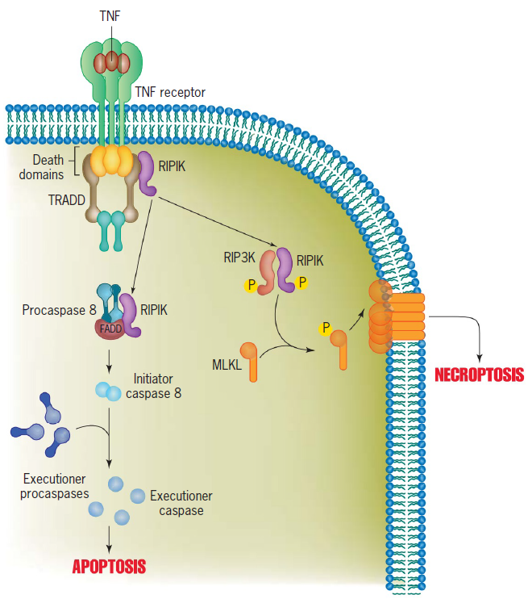
The Extrinsic Pathway of Apoptosis
Apoptosis can be triggered by external signals as well as internal signals.
When TNF binds to a TNF receptor (TNFR1), the activated receptor binds the cytoplasmic adaptor protein TRADD and additional signaling proteins including the kinase RIP1K. The cytoplasmic domains of the TNF receptor, FADD, TRADD, and RIP1K, interact with one another by homologous regions called death domains that are present in each protein. In the apoptotic pathway, RIP1K associates with the adaptor protein FADD and procaspase‐8. Once assembled in the complex, two procaspase molecules cleave one another to generate an active caspase‐8 molecule containing four polypeptide segments. Caspase‐8 is an initiator complex that activates downstream (executioner) caspases that carry out the death sentence. In the necroptotic pathway, the RIP1K associates with another kinase, RIP3K to form the active necroptosome. RIP3K phosphorylation of MLKL is thought to allow MLKL to translocate to the membrane and oligomerize to form channels that allow for cytoplasmic leakage. It can be noted that the interaction between TNF and TNFR1 also can lead to cell survival rather than self‐destruction.

Slide 7
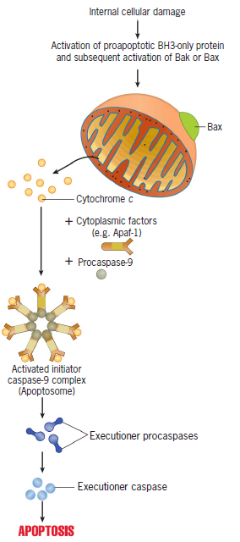
The Intrinsic Pathway of Apoptosis
Various types of cellular stress cause proapoptotic members of the Bcl-2 family of proteins–either Bax or Bak–to oligomerize within the outer mitochondrial membrane, forming channels that facilitate the release of cytochrome c molecules from the intermembrane space. Once in the cytosol, the cytochrome c molecules form a multisubunit complex with a cytosolic protein called Apaf‐1 and procaspase‐9 molecules. Procaspase‐9 molecules are apparently activated to their full proteolytic capacity as the result of a conformational change induced by association with Apaf‐1. Caspase‐9 molecules cleave and activate executioner caspases, which carry out the apoptotic response. The intrinsic pathway can be triggered in some cells (e.g., hepatocytes) by extracellular signals. This occurs as the initiator caspase of the extrinsic pathway, caspase 8, cleaves a BH3‐only protein called Bid, generating a protein fragment (tBid) that binds to Bax, inducing insertion of Bax into the OMM and release of cytochrome c from mitochondria.

